Slide 1

Career Pathways Training for VR Professionals
July 9, 2018
DSS Central Regional Office Training Center
1604 Santa Rosa Road, Richmond
Dr. Maureen McGuire-Kuletz, GWU
Dr. Rob Froehlich, GWU
Dale Batten, DARS
Pam Hinterlong , DBVI
Emily West, DARS
Kate Kaegi, DARS
Tish Harris, DBVI
Paula Martin, DARS

Slide 2

Welcome
Opening remarks from our Leaders

Slide 3
Norms for today
Computers/Phones/Focus
Approach with a spirit of inquiry
Task yourself to learn at least 2 new things today
We’re going to take a journey today.
We will do our best to cover everything, but our most important goal is to bring you some worthwhile discussion about this contemporary approach to VR services.
Thanks for your flexibility.

Slide 4
Who Is Here Today?
Counselors?
Placement Professionals?
Regional Directors?
Administrators?
Others?

Slide 5
Training Objectives
By participating today, you should be able to:
Describe why occupational clusters and career pathways are important to VR.
Identify career pathways and how to integrate the concept into VR process.
Include new and expanded information to your career counseling approach, including how high demand occupations in different regions can benefit clients in terms of salary.
Expand your consideration of support services, particularly Assistive Technology and how it can increase an individual’s career options/considerations.

Slide 6
Pre-Test/Post-Test
Demonstrate your Career Pathways knowledge here.
After the training we’ll circle back and look at how you’ve expanded your knowledge or added to your career pathways approach.

Slide 7
In Advance of This Meeting
You reviewed:
Podcast giving you general information dealing with Career Clusters and Career Pathways.
The ‘What is WIOA and How Does It Relate to Vocational Rehabilitation Services and CPID?’ presentation.
Instructional materials relating to the Career Index Plus (TCI+).

Slide 8
Thank You for Preparing
We will expand on that information throughout the day and will talk to how it fits in when using a Career Pathways focused approach.
Please email Susan Gaillard if you would like to receive CRC Credit for the time you spent reviewing these pre-session materials at Susan.Gaillard@dars.virginia.gov
Also, please note these materials along with this presentation will be made available at the CPID website located at: https://www.vadars.org/gsp/cpid/cpid_home.htm

Slide 9
CPID and WIOA

Slide 10
It’s Not Just a Project…
There is a much larger umbrella under which CPID exists
Career Pathways are a new way of looking at employment and changes how the system (and VR as a part of that system) looks at accessing employment.
https://careerpathways.workforcegps.org/resources/2016/10/20/10/11/Enhanced_Career_Pathways_Toolkit

Slide 11
Some Highlights
"WIOA provides … an integrated, job-driven, public workforce system that links diverse talent to businesses. This revitalized workforce system includes three critical hallmarks of excellence:
The needs of business and workers drive workforce solutions;
American Job Centers work with consumers and businesses; and
The workforce system supports strong regional economies and plays an active role in community and workforce development.

Slide 12
Partners
Adult education, postsecondary education, and other partners collaborate …so Americans can attain the skills and credentials needed for jobs in their regional economy.
Workforce, human service, and educational systems must be in alignment through cross-agency planning, sharing common performance measures that inform data-driven decision making, and develop strategies for sector partnerships and career pathway systems and programs at the Federal, state, and local levels.
The State Plan ensures that all state agencies play a role in the development of a vision for a career pathways state system, as well as how the state system interplays with regional and local career pathways and career pathways plans.“

Slide 13
Career Pathways and Clusters

Slide 14
Career Pathways
The Career Pathways Work Group developed a shared definition during the writing of the strategic plan:
“We define our career pathways system as a series of connected education and training programs and support services that enable individuals to secure employment within a specific industry or occupational sector and to advance over time to successively higher levels of education or employment in that sector. Each step on a career pathway is designed explicitly to prepare for the next level of employment and education.”

Slide 15
Sector Strategies
“Sector strategies are partnerships of employers within one industry that bring government, education, training, economic development, labor, and community organizations together to focus on the workforce needs of an industry within a regional labor market. At the state level, they are policies and investments that support the development of local sector partnerships. Sector strategies can do the following:
Address current and emerging skills gap
Provide a means to engage directly with industry across traditional boundaries
Better align state programs and resources serving employers and workers”
Source: National Governor’s Association

Slide 16
Career Clusters
Career Clusters help students investigate careers and design their courses of study to advance their career goals. For this reason, Virginia has adopted the nationally accepted structure of career clusters, career pathways and sample career specialties or occupations.
A Career Cluster is a grouping of occupations and broad industries based on commonalities. Within each career cluster, there are multiple career pathways that represent a common set of skills and knowledge, both academic and technical, necessary to pursue a full range of career opportunities within that pathway – ranging from entry level to management, including technical and professional career specialties. Based on the skills sets taught, all CTE courses are aligned with one or more career clusters and career pathways.

Slide 17
How Do Clusters and Pathways relate to my work as a Counselor?
Industry Cluster
Career Cluster
Career Pathway
Manufacturing Cluster
Production Pathway
Logistics and Inventory Pathway
Maintenance Pathway

Slide 18
Why Focus on Specific CPID Pathways?
Manufacturing
Logistics
IT
Why were these Pathways selected?
What is the relationship to LMI in region?

Slide 19
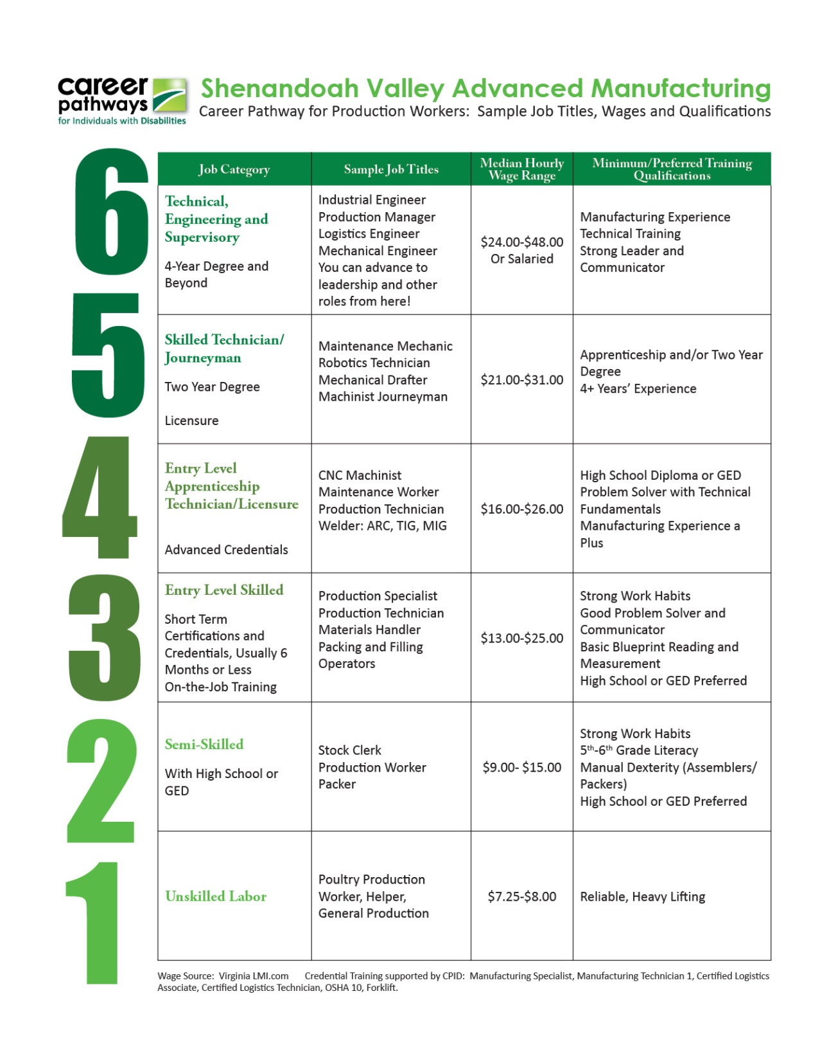

Slide 22
Some Project Particulars…
CPID provides opportunities for independence by building access to career pathways for individuals with disabilities through provision of additional services, tutoring, training and getting the accommodations and assistive technology needed to train, obtain employment, and stay employed.
The CPID grant also seeks to identify and bridge gaps in career pathways for individuals with disabilities, and build best practices in Career Pathways.

Slide 23
Career Pathways Grantees
CPID Projects beyond Virginia
Three other states were awarded the CPID Grant
Nebraska - http://www.vr.nebraska.gov/pathways/
Georgia- https://prezi.com/kvlixvzsd_mf/e3-presentation/?utm_campaign=share&utm_medium=copy
Kentucky- https://kcc.ky.gov/Office-for-the-Blind/projectcase/Pages/default.aspx

Slide 24
Some Other Parts of the Equation

Slide 25
Industry Partners
VMA – Manufacturing Skills Institute
Industry Forum opportunities
Accessibility Benchmark System
Disability Advocacy
NVTC
Webinars
Titan Events
Participation in Subcommittees

Slide 26
Business Engagement
The VR Workforce Studio – available in iTunes or at vrworkforcestudio.com
Tours
Demand Side Meetings
Foundations/ Community Organizations

Slide 27
As We Move Along Today…
We intend to give you more information relating to the various moving parts (resources, assessments, supports, funds, reporting, etc.) and why a Career Pathways approach can be helpful as you collaborate with your client through all phases of the rehabilitation process.

Slide 28
Activity 1 CPID Baseline Discussion
Talk in small groups about the following:
Have you already interacted with the CPID Project?
What activities, assessments, resources, trainings or other CPID initiatives have impacted the work you do with your clients and in what ways?
Beyond CPID, how does a Career Pathways approach fit with what you already do with clients and in what ways is it different?

Slide 29
Career Pathways and Establishing the Employment Goal

Slide 30
The Employment Goal
All our efforts have a direct relationship to the Employment Goal.
Let’s look at how Career Pathways directly relate to IPE Development and the employment goal.

Slide 31
IPE Guidelines and Considerations for Development
A Springboard for our Discussions Today

Slide 32
IPE Development Tool
Establishing an Employment Goal
Employment Goal Considerations
IPE Supporting Services

Slide 33
Establishing an Employment Goal
How Does a Career Pathways Approach Support This Task?

Slide 34
Traditional Assessment Approaches for Goal Development
Intake Interview (G & C)
Vocational Evaluation (Paper/Pencil)
Vocational Evaluation (WWRC or VRCBVI)
Situational Assessment Case Staffing
Online Resources

Slide 35
Applying CPID Sources of Information
Academies – exploration of technology careers through tours, project, presentations and friendly competitions
Tours
Resources
Loaner library
AT eval and / or recommendation to the DARS AT specialist
Occupational and / or Physical Therapy if needed
Ergonomic / Work site evaluation
Adult Education
Behavioral Support

Slide 36
Beyond Paper and Pencil
Some clients benefitting from CPID may have been ‘ruled out’ by traditional measures.
Pathways Approach is about ‘ruling in’ (expanding vocational exploration; provision of innovative accommodations; assistive technology; learning supports) as opposed to ‘ruling out’.
Academies have impacted many individuals relating to their learning about occupational information.

Slide 37
Motivational Interviewing and the Employment Goal
Workforce Partners and approach used in this project
Shared language of MI
Some applicable MI principles
Counseling and Guidance can be enhanced with MI

Slide 38
Some MI Basics
MI is all about Change – You are getting consumer to talk themselves into change
Conversation not inquisition – turn those questions into statements
Make educated ‘guesses’ and the consumer will latch on, or will tell you you are wrong…
Reflection and consumer readiness ‘There’s a Nail in Your Head’

Slide 39
MI Spirit – Things to Remember
Here’s the hard part – no advice!
Avoid being “Dr. Judges-Too-Much”
Give folks – ‘A Menu of Options’
Reinforce change process (affirmations); non-attending skills for sustaining status quo
Many simple techniques –
Importance and Confidence Rulers: Scaling 1 – 10:
How Important is this to you? (Build Importance – Why are you at a 6 and not a 2 or 3?)
How confident are you? Build Confidence –( What would it take to go from a 6 to an 8?)

Slide 40
Tools to Evoke Change Talk
Querying Extremes – What concerns you most about being employed? What would be the best results if you make this change? You have no time to make this change…
Looking back – Remember back to when you were employed before the accident.. What was your life like?
Looking forward – If you decide to make this change, how will your life be different?

Slide 41
Career Pathways – A Different Direction
Many times we focus from the ground up and look at all the variables we discussed relative to building up to an employment goal.
Sometimes we can benefit from looking at the goal then down onto the match between the person and the environment.
CPID attempts to innovate the job selection process with a heavy emphasis on labor market information and career progression.
CPID Scenario… the basics summed up in a real world example.

Slide 42
Working Lunch
Success Scenarios - Sam Rothrock and team in Richmond.

Slide 43
Career Fund of Knowledge
Decision making is informed and enhanced via increasing an individual’s fund of career related knowledge.
Expanding the pool of viable employment outcomes is directly related to the information individuals have relating to the world of work.
We’re going to discuss several ways to enhance and add to that career related fund of knowledge.

Slide 44
TCI+ and Employment Goal Considerations

Slide 45
Employment Goal Considerations
Consumer’s Physical, Mental, or Cognitive Limitations
Clients prior education, training and employment history
Labor Market
Legal Barriers (Criminal record or Driving Record)
License, Degree, or Certificate Requirements
Training Requirements (Time Frame)
Consumer’s Salary or Wage Requirements
Consumer’s Scheduling Needs (PT, FT, Days, & Hours)
Other factors

Slide 46
Using TCI+
Let’s use CI+ to look at one of the positions described earlier on the Advanced Manufacturing Career Pathway graphic.
CI+ can get you information about ‘Manufacturing Production Technicians’ on all these various employment goal considerations.
You and your client can decide how the position matches/does not match his or her needs or situation.

Slide 47
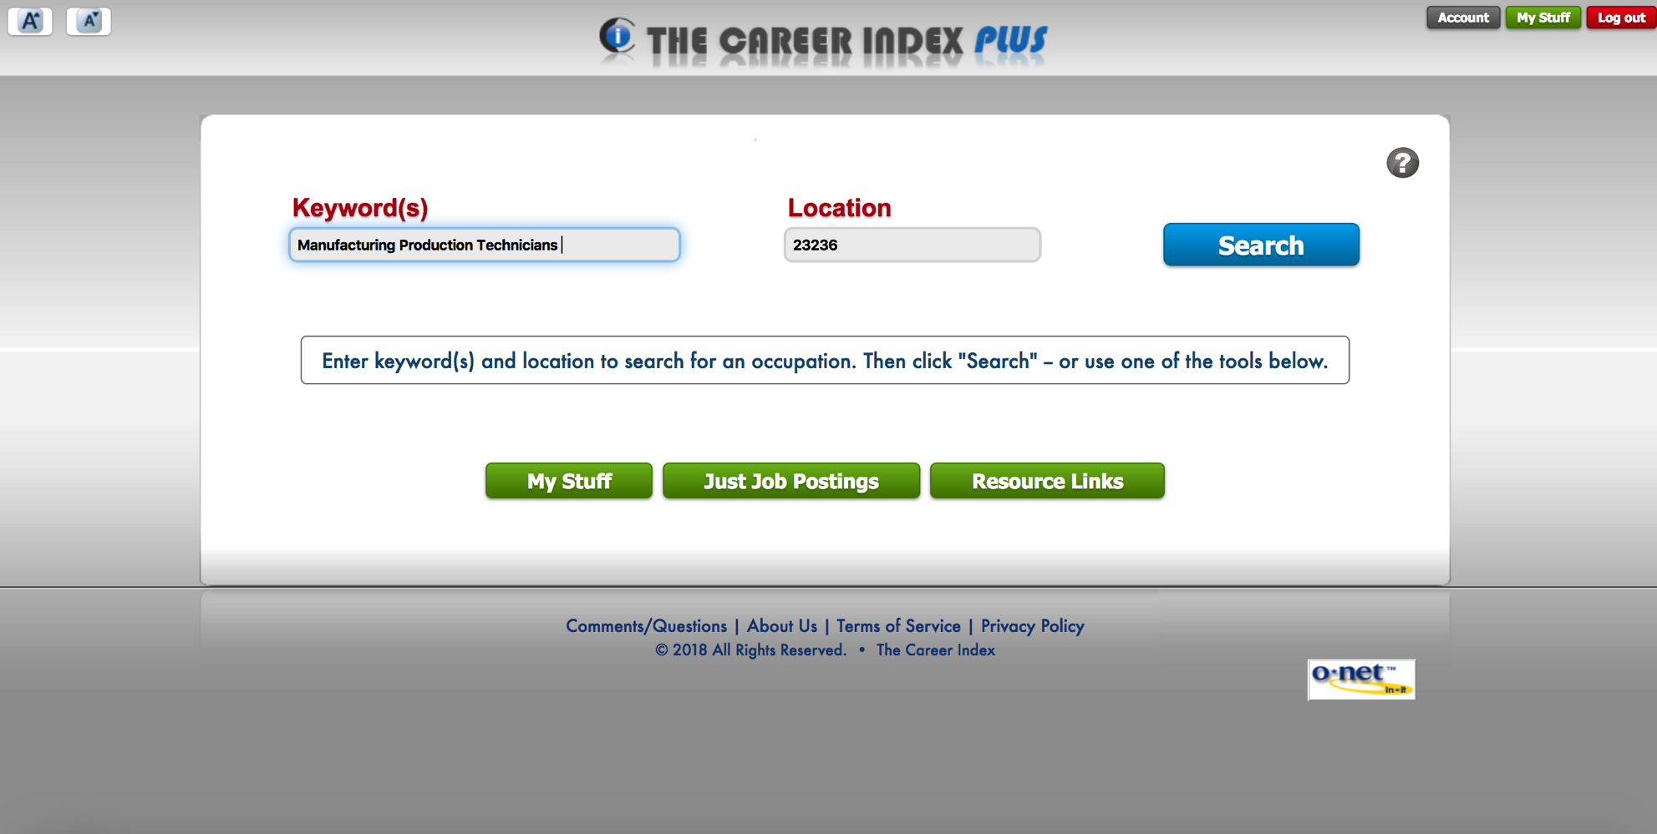
Manufacturing Production Technician

Slide 48
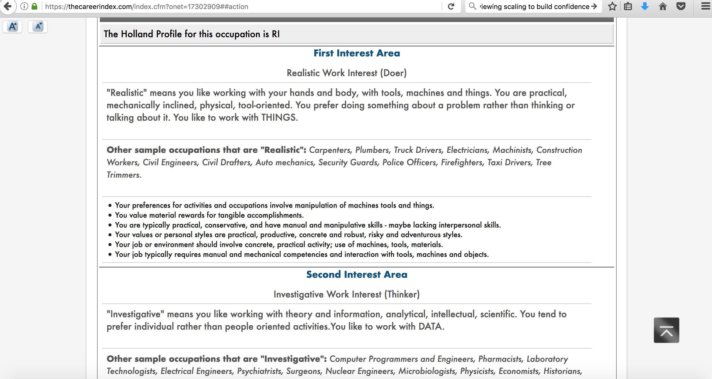
Suitability Tab - Interests

Slide 49
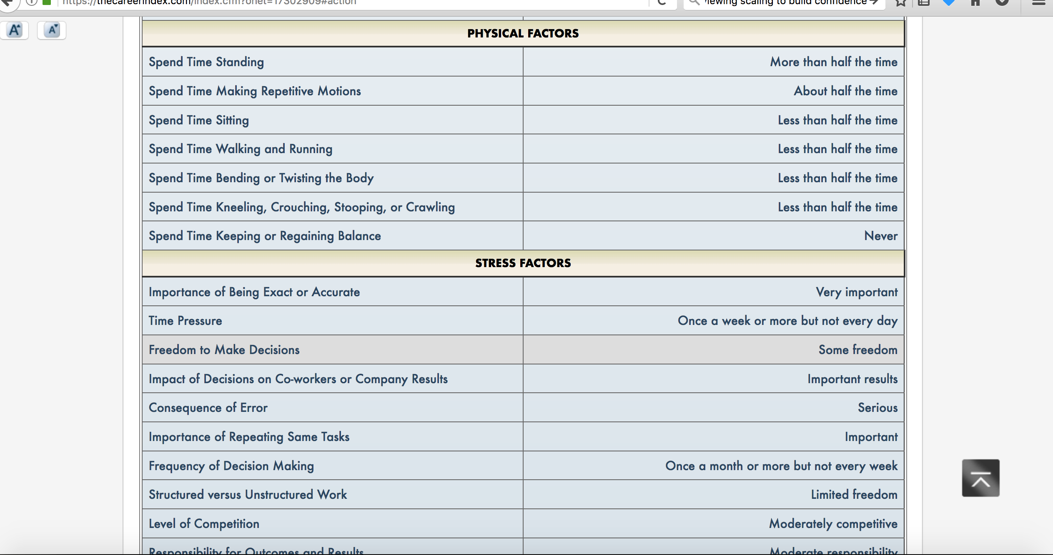
Suitability – Work Context

Slide 50
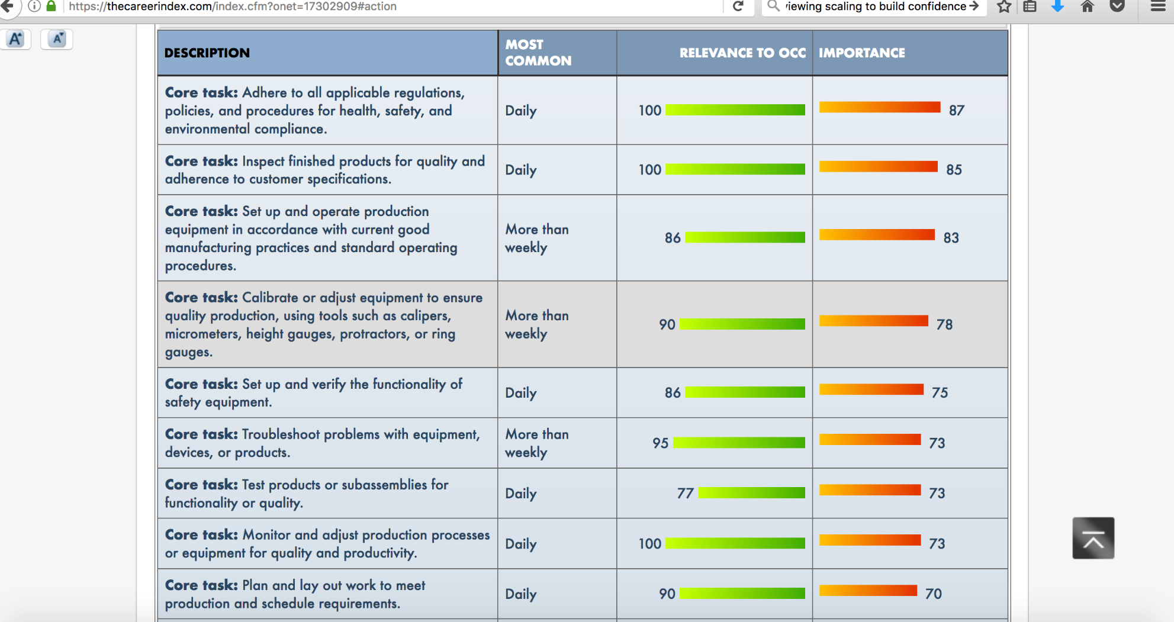
Suitability - Tasks

Slide 51
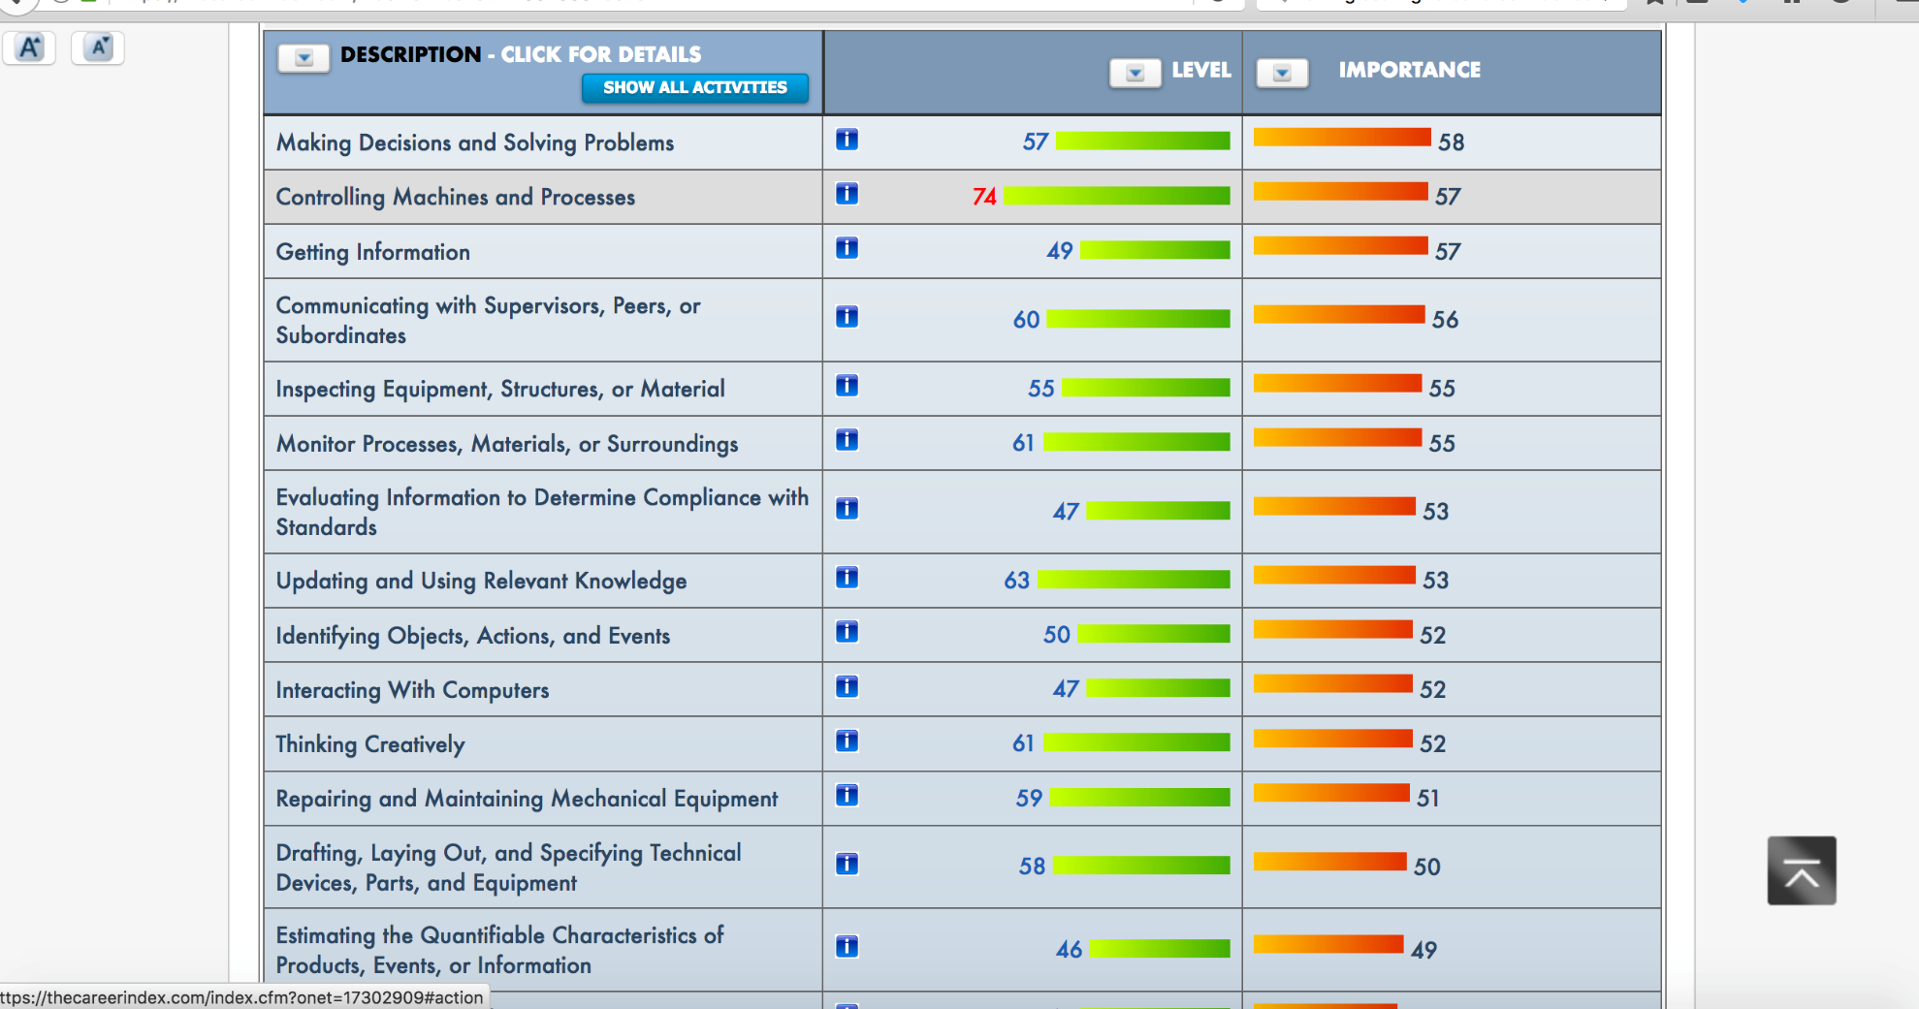
Suitability - Activities

Slide 52
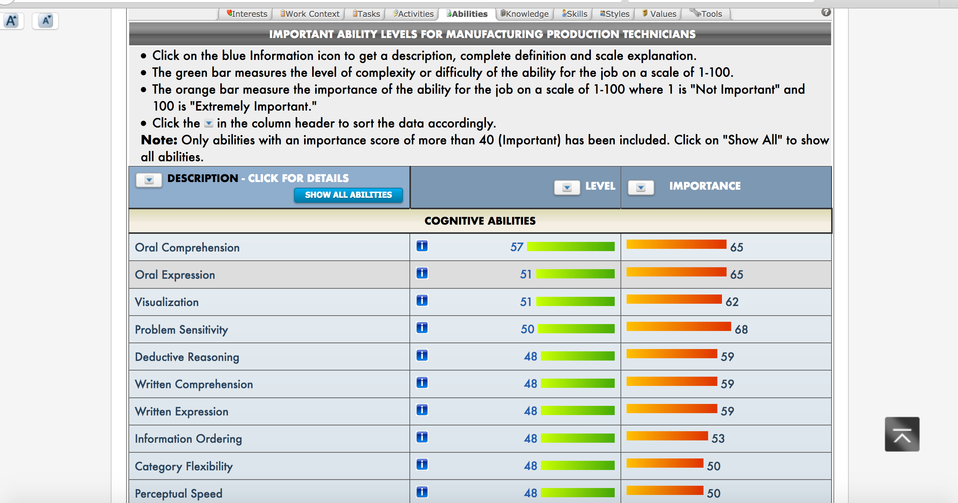
Suitability - Abilities

Slide 53
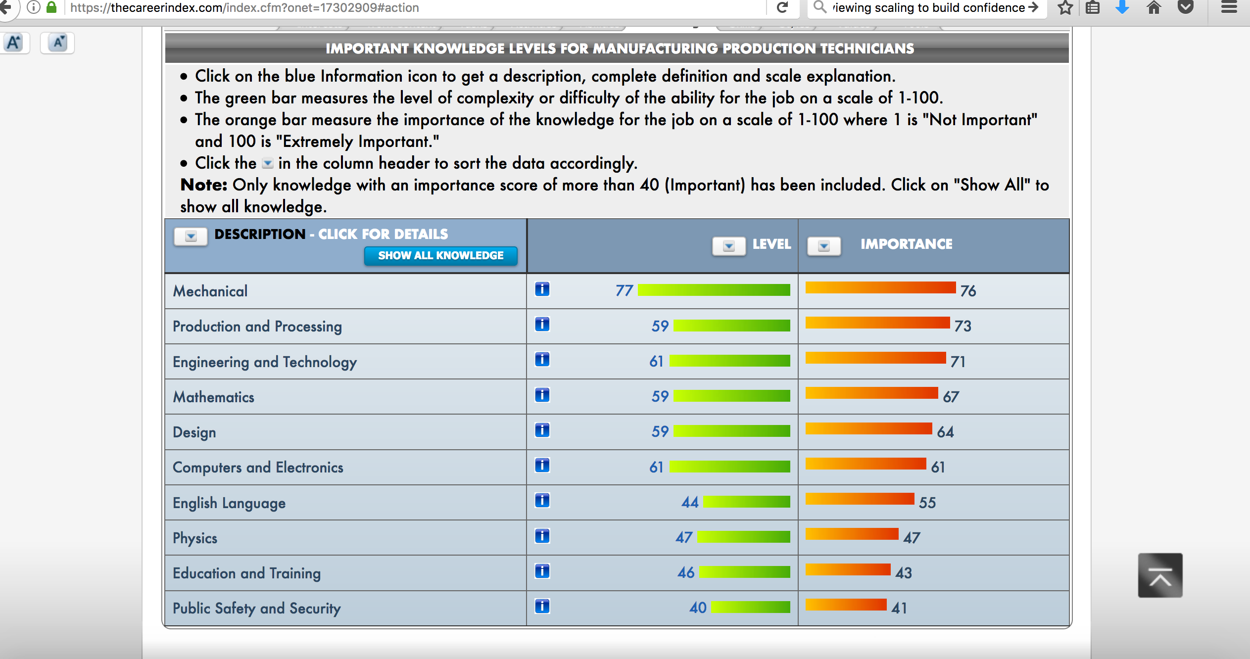
Suitability – Knowledge Levels

Slide 54
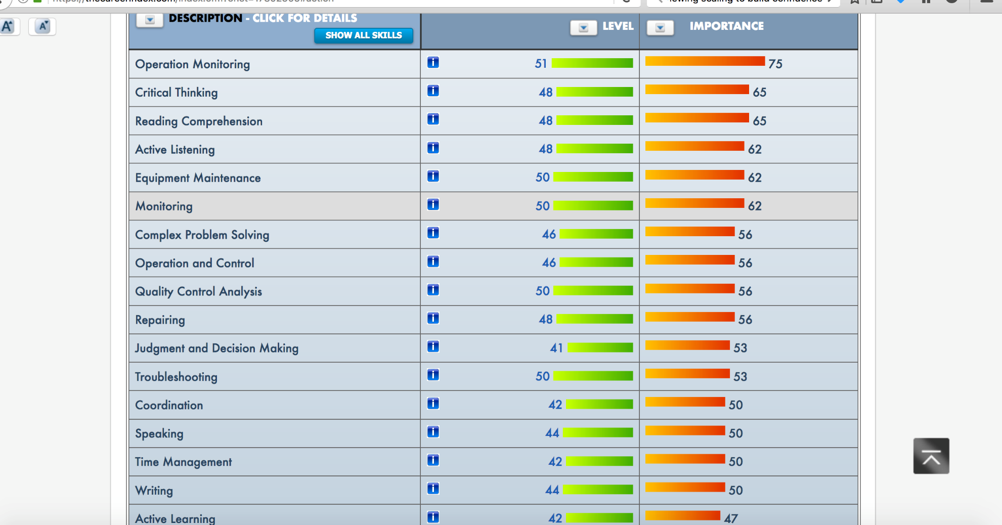
Suitability – Skill Levels

Slide 55
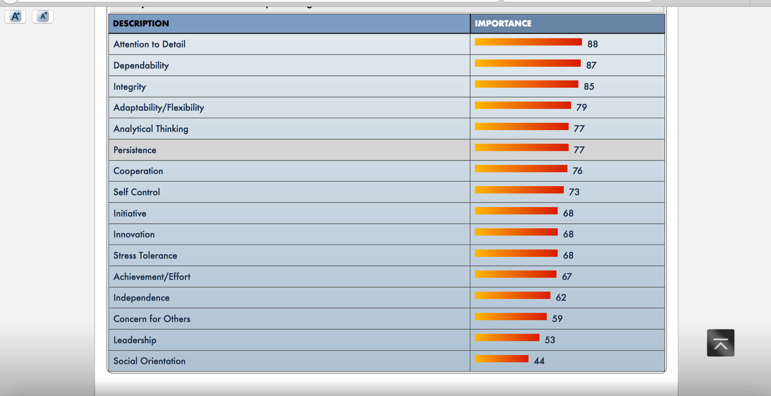
Suitability – Work Styles

Slide 56
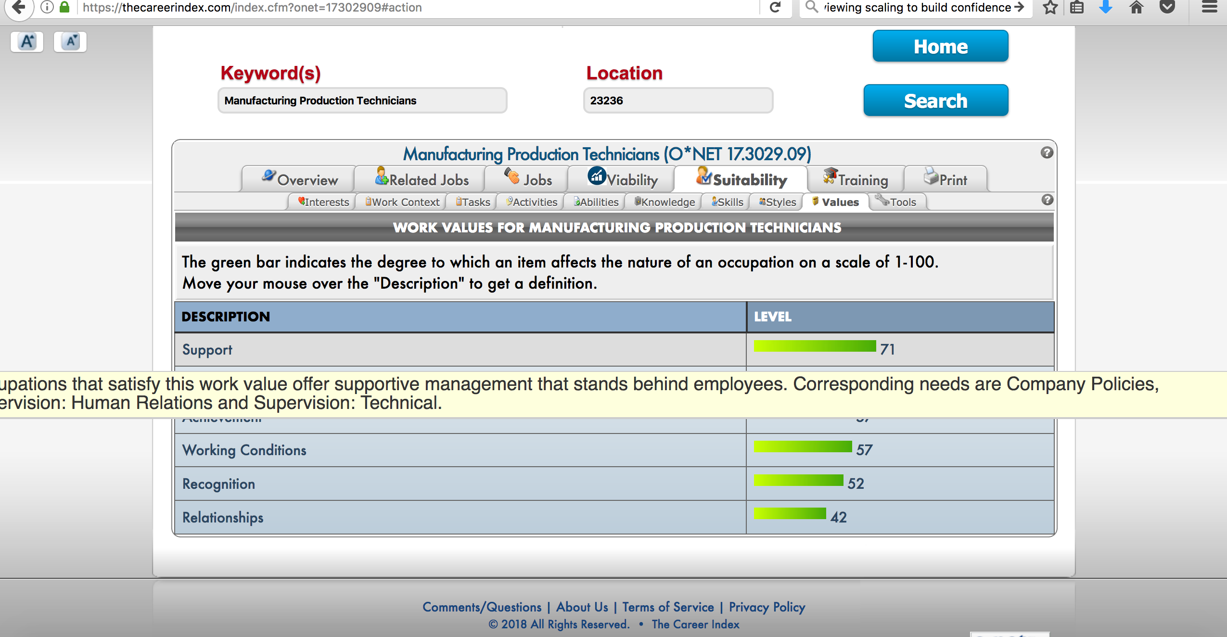
Suitability – Work Values

Slide 57
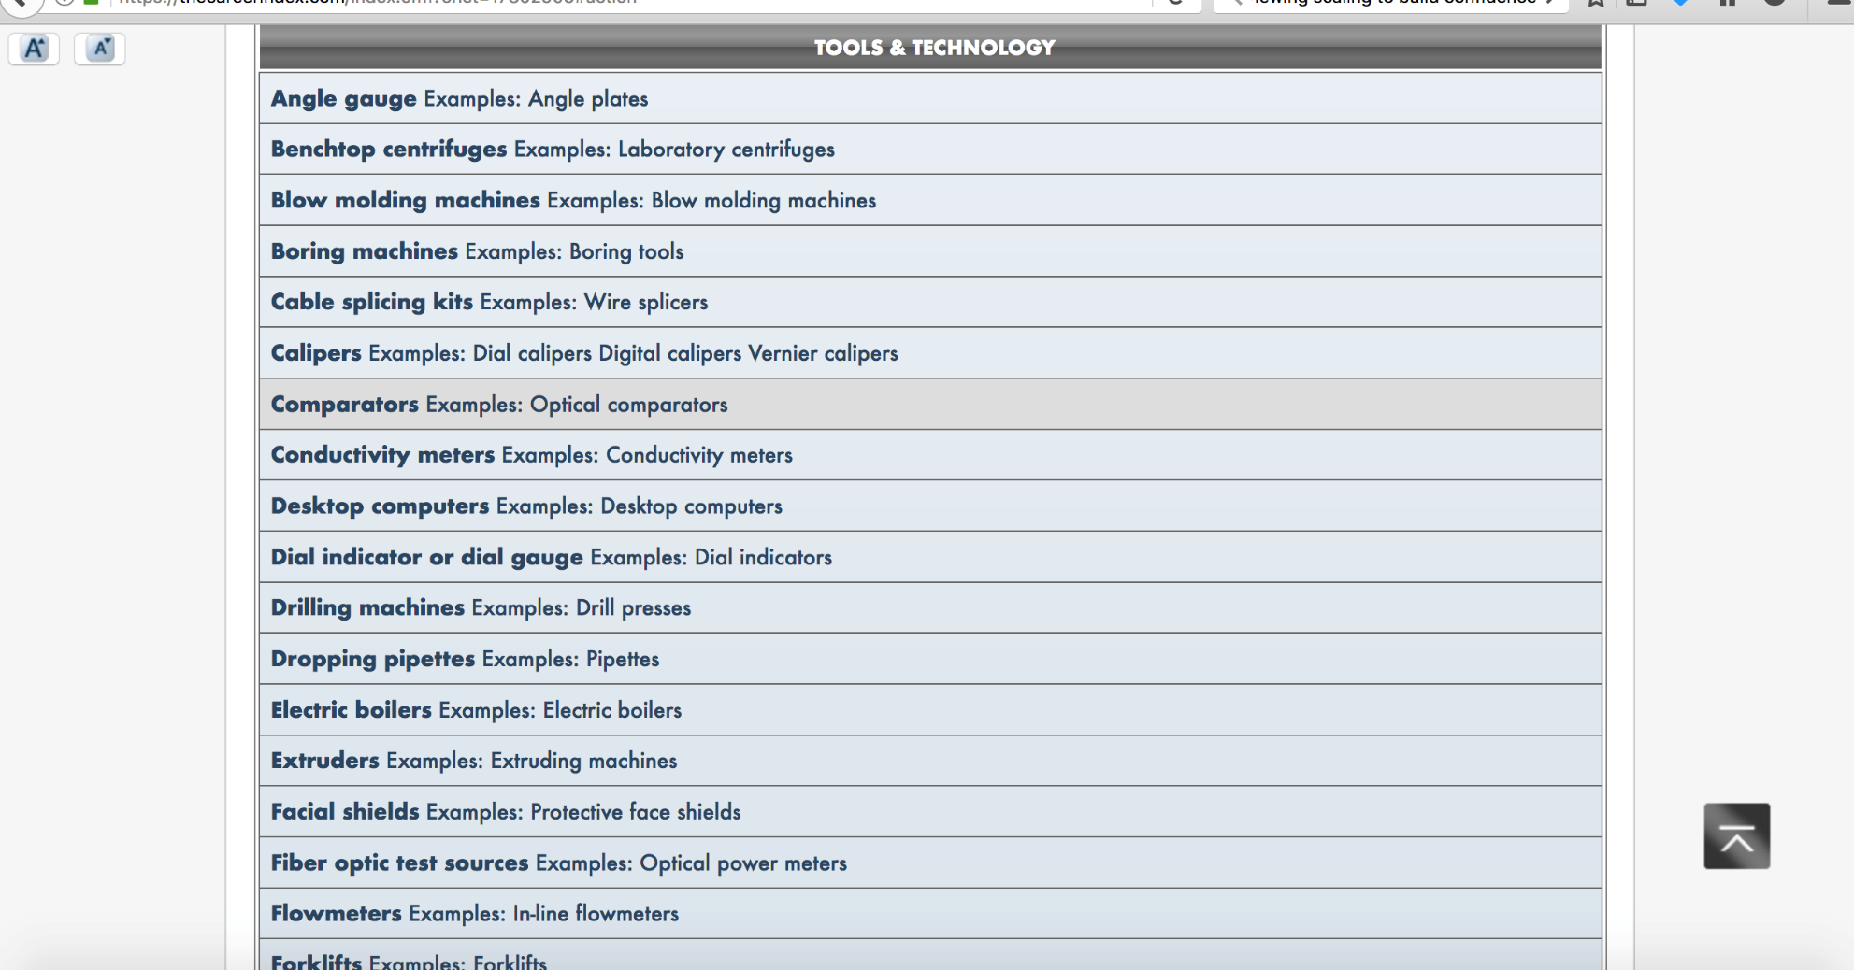
Suitability - Tools

Slide 58
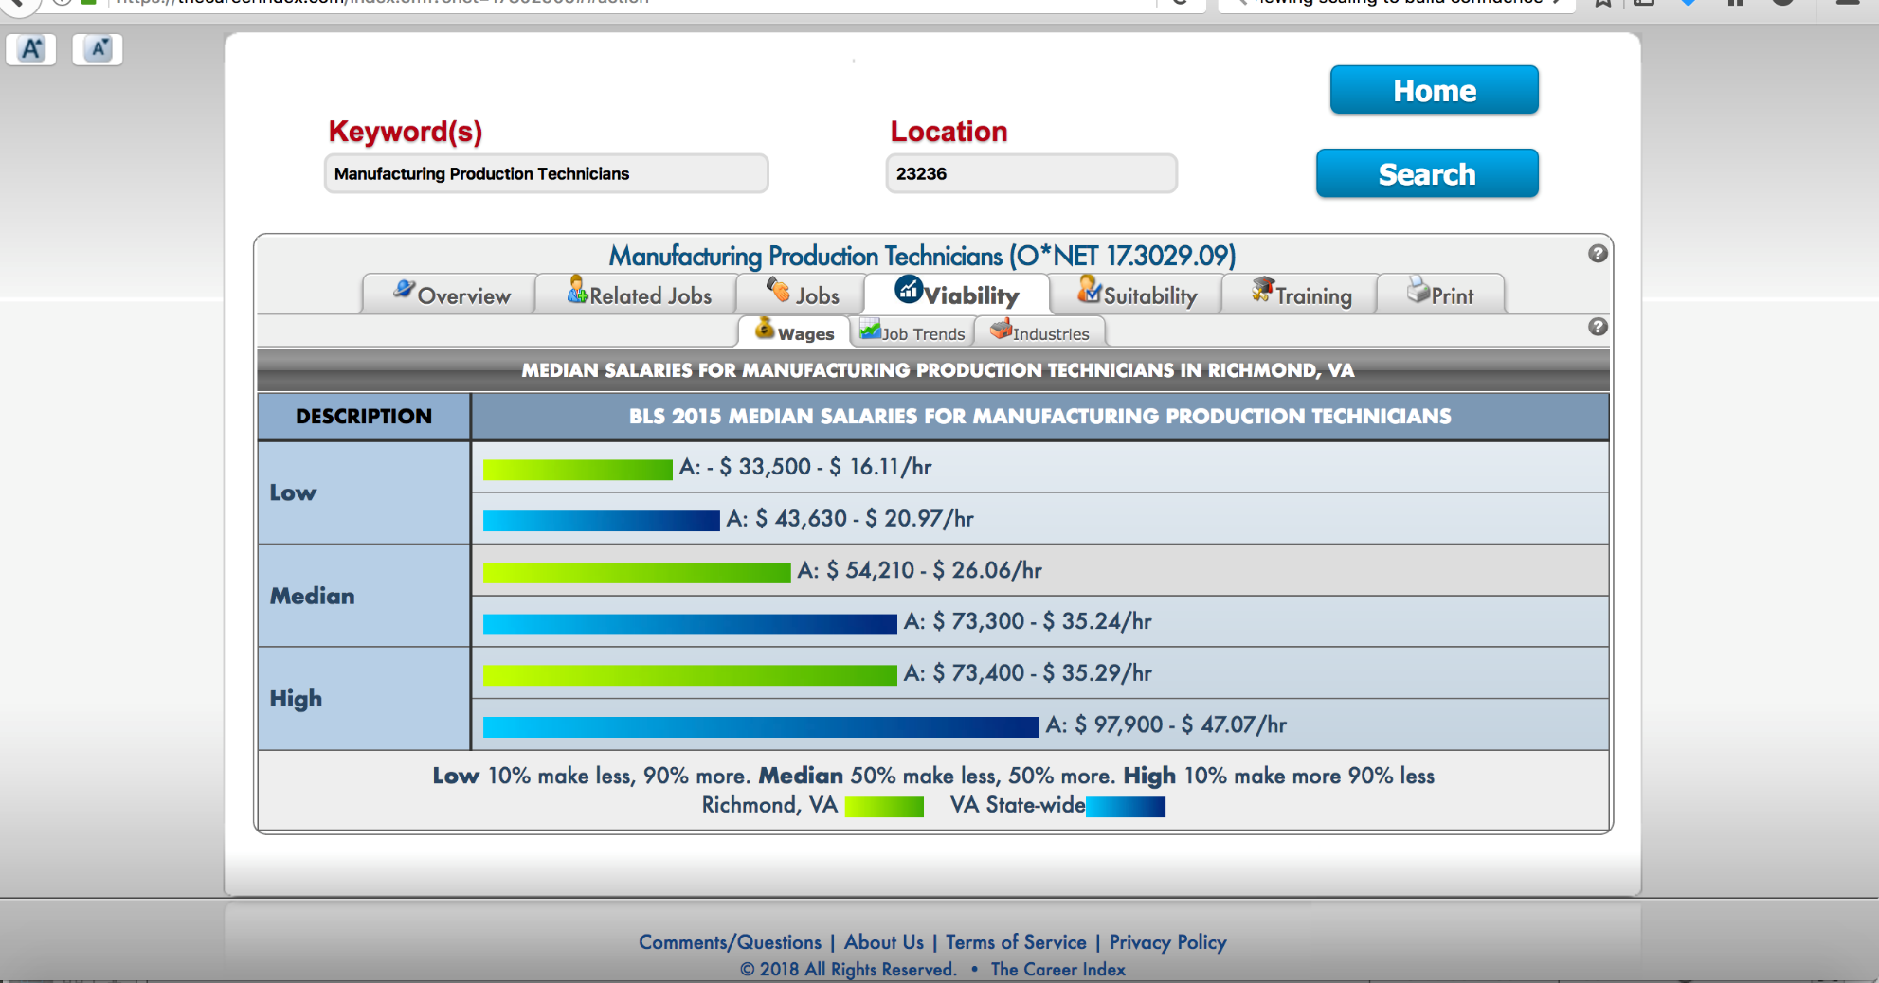
Viability Tab - Wages

Slide 59
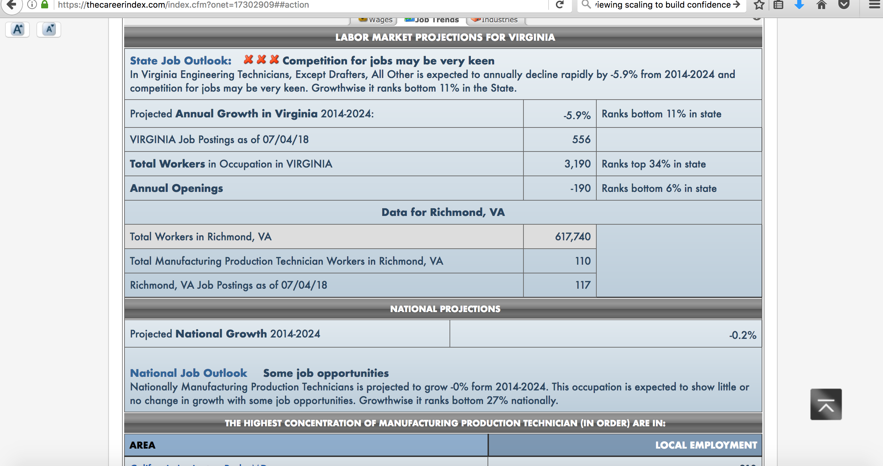
Viability – Job Trends

Slide 60
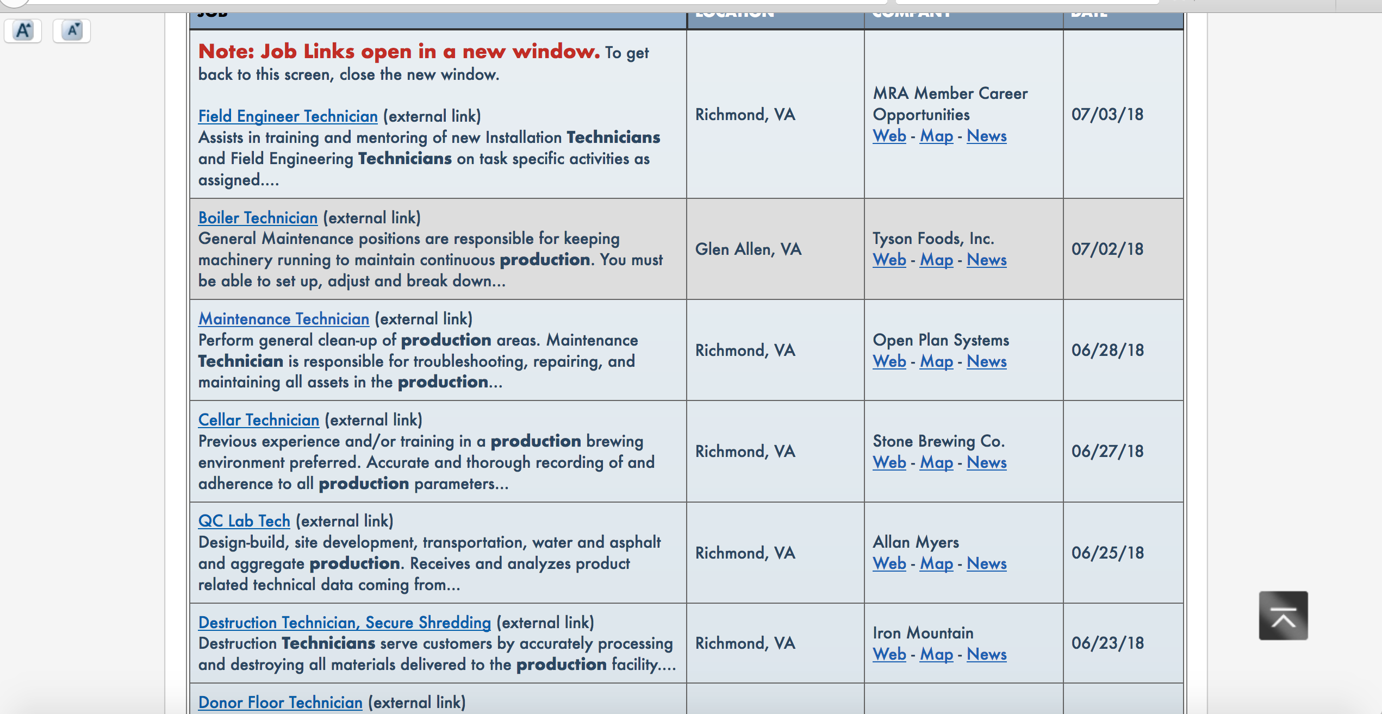
Jobs Tab – Clicking on Hyperlink brings you to Indeed.com and the Actual Job Posting

Slide 61
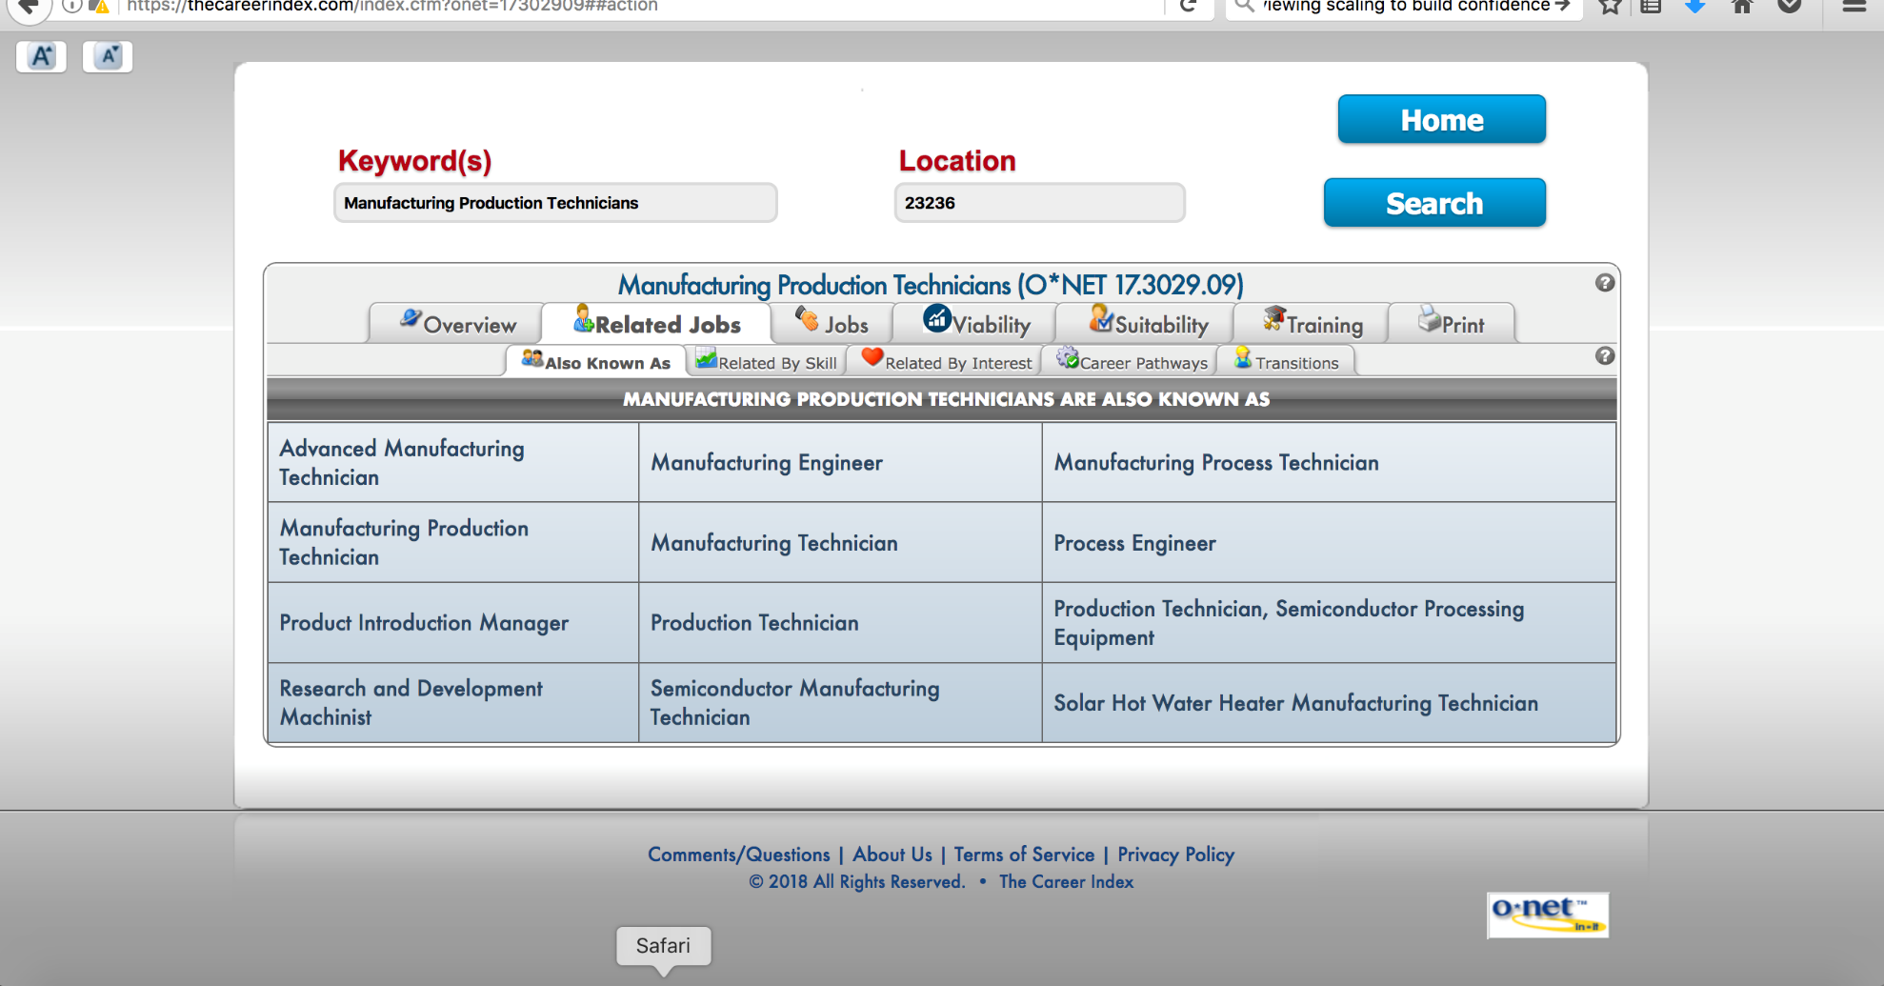
Related Jobs Tab

Slide 62
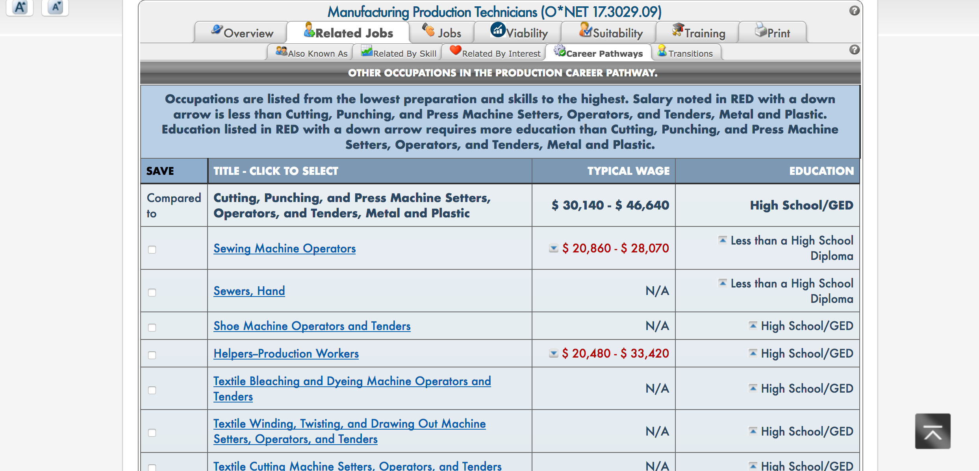
Related Jobs – Career Pathways

Slide 63
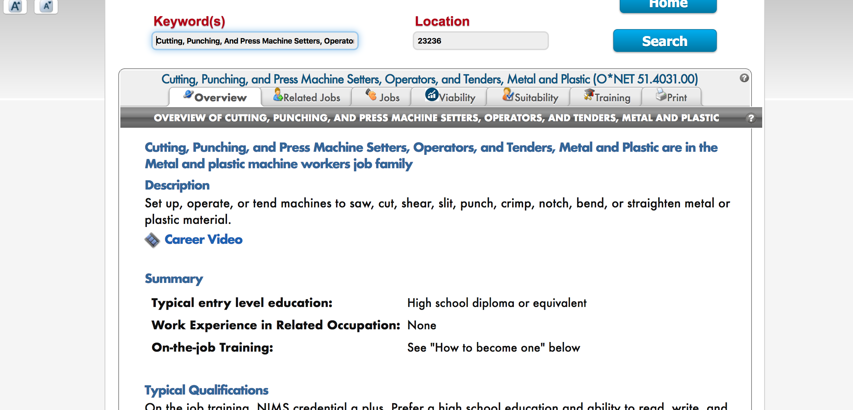
Related Jobs – When you click hyperlink…

Slide 64
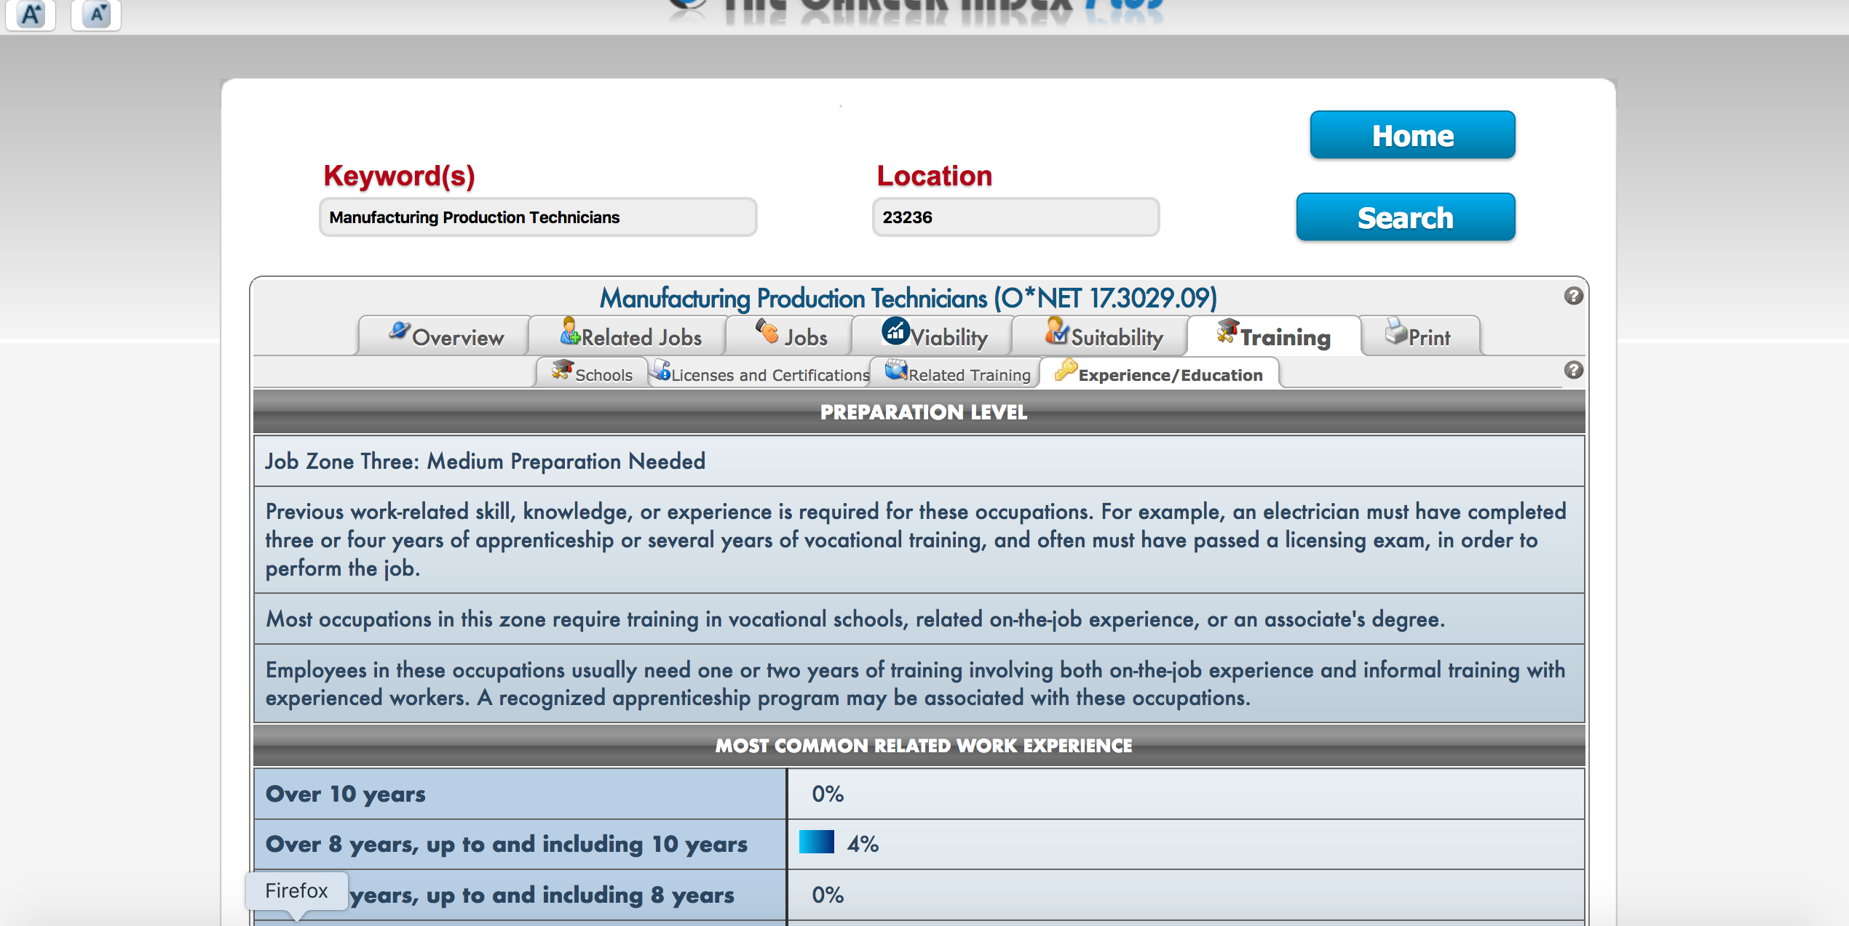
Training Tab

Slide 65
Some TCI+ Closing Thoughts
This is to inform the counseling/selection process… it’s not a ‘TCI+ said you should be an accountant’ type of thing.
Don’t allow for information overload!
A word about the ‘Overview’ tab
You can assign homework and share reports between you and consumers.
The ‘My Stuff’ tab

Slide 66
Beyond The Career Index+
A Career Interests Game Game from the University of Missouri. Basic Holland Code set up where you imagine being at a party and deciding on who you would like to talk to by clicking on the choices.
Dream it Do it Virginia Explore your career by looking at your interests, work preference, profile your skills and consider some hands on academies. This free site is sectioned into Explore, Ready, Train, Assess and Employ. Includes videos and job listings.
My Next Move Interactive toolkit from O*net that lets you look at your career options. Includes tasks, skills, salary information and over 900 different careers.
My Skills My Future Career One-stop self assessments. Looks at Interest, skills and work values. Also includes a section to further explore career choices and career planning. App is also available at Career Onestop Mobile.
Occupational Outlook Handbook Looks into the nature of work, training, education, earnings, job prospects and working conditions. This is a national outlook.
Virginia View Statewide look at careers. Includes regional median wages, school links, outlooks, job titles etc.. Resources also has interest inventories, professional web links, apprenticeships, financial aid information, and job readiness.

Slide 67
More Resources
O*net Academy To keep pace with the rapidly changing work environment and to keep your knowledge of O*NET fresh, you need high quality training that is relevant timely and online! From self-paced courses and tutorials, to live webinars, O*NET provides you with high caliber online learning 24 hours a day.
Northstar digital Literacy Assessment Examines basic skills needed to perform tasks on computers and online. assessed through online, self-guided modules. Included are basic computer digital literacy standards and modules in ten main areas: Basic Computer Use, Internet, Windows Operating System, Mac OS, Email, Microsoft Word, Social Media, Microsoft Excel, Microsoft PowerPoint, and Information Literacy.
Pathsource App Includes an interest inventory that will recommend careers in an easy to use format. Includes lots of videos and in-depth career information.
Get That Gig App Fun memory card game from the CPID grant in Georgia. Learn about jobs in high demand and skills you'll need to succeed. Includes who's hiring; To your health; Around the house; Dress the Part; and Feeling it.
Internship.com Listed internships available in local area. Also includes an internship predictor. Students can filter search results to display paid internships, summer jobs or entry level jobs.

Slide 68
Activity 2
Jane arrived at WWRC for Computer Repair. While in her training program she faced some significant setbacks with her health and living situation. Jane is no longer interested in Computer Repair and needs to explore an alternative goal.
How can you use career pathways and career clusters to inform your work with Jane?
How would labor market information inform your research with Jane?
What resources relative to CPID might be helpful in gathering more information for Jane?

Slide 69
Jane and Outcome
Jane participated in a CPID Academy. She reported to her counselor that she found manufacturing and logistics very interesting and thought this may be something she would be good at.
Jane’s counselor asked for a focused evaluation from Voc. Eval. and results showed that Jane had the aptitude for the MTT class.
Jane attended MTT with technical assistance from CPID
After graduation Jane attended her “Next Steps Meeting” and found out that there were not a lot of manufacturing positions in her home area so Jane worked with her counselor and CPID to relocate.
The BDM found a position that she was interested in and she was hired!
Notes:
paula

Slide 70
We Have a Potential Goal. Can CPID Help?
Some of the Who and What Functions or Counselor FAQ’s

Slide 71
General FAQs
Is CPID for anyone in the state?
Is it only for folks with a goal that CPID focuses on?

Slide 72
Matching Clients with Pathways
General guidance relative to the demands of the certifications; potential work settings; demands.
Context/examples – Look beyond minimum capabilities and toward ways to work with client to reach goals.
Resilience and ‘Grit’ go a long way.

Slide 73
How do I know who is appropriate for which Pathway/Certification?
Assessment/ Education level- Math and reading levels
PluggedIn model
Collaboration with adult education
Soft Skills- accountability, teamwork and maturity

Slide 74

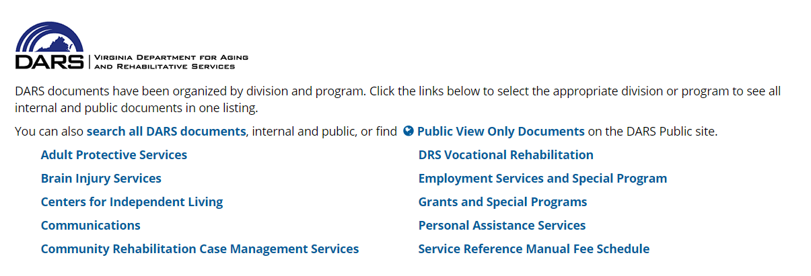
Document Repository: What Do I Need to Know?
Notes:
I put in DBVI- it can be put on a separate slide but did not want to renumber everything…….can be found in the Grants and Special Programs link on the DARS Document Repository. DBVI simply search CPID and all come up!
DBVI documents can be found…..

Slide 75
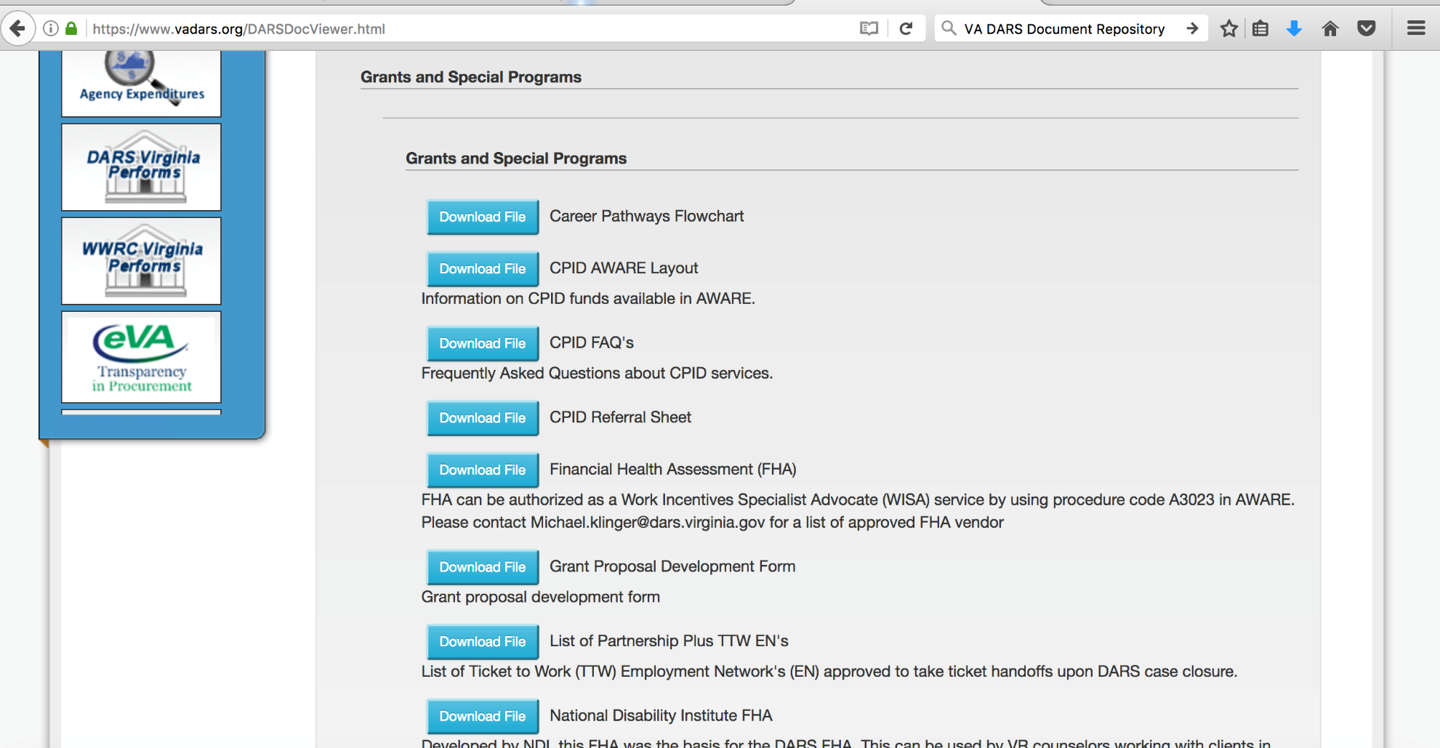
DARS CPID

Slide 76
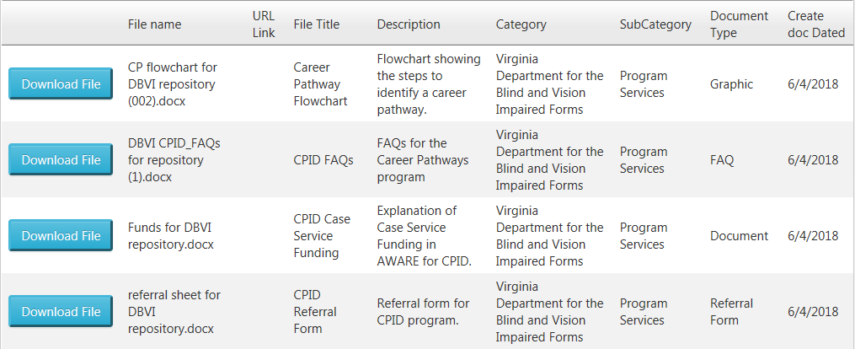
DBVI Document Repository

Slide 77
CPID Funds in AWARE
Case service funding is available for CPID participants in AWARE. CPID may fund on a case by case basis:
Stipends
Paid internships
OJT
Job coach training services
Travel
Tuition
And comprehensive services support:
Therapeutic Behavioral Services (TBS)
MT1 assessments
Assistive Technology
Job Coaching for manufacturing training and other career pathways in community programs such as community

Slide 78
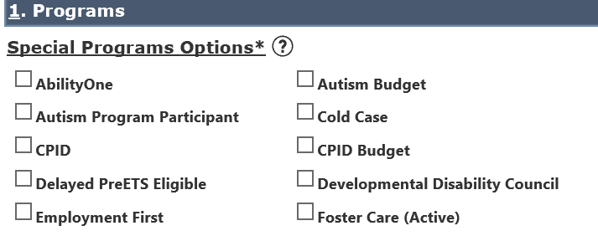
AWARE Touch Points
Special Programs

Slide 79
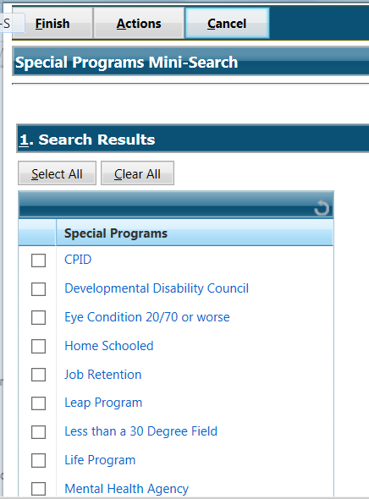
DBVI AWARE
In AWARE
Click special programs

Slide 80
Work Smarter, Not Harder
How do I get a sense of how much time it takes to get someone on a career pathway?
What can Career Pathways Approach/CPID do to make me more efficient/have better outcomes/etc.?
Notes:
CPID is extremely responsive to counselor inquiries. For instance NOVA CC to private provider. We are working to try to overcome barriers for clients.

Slide 81
Performance Measures
Regional Manager
WIOA is a new model and begins a new day in Vocational Rehabilitation
There is now a greater focus on quality of outcomes as opposed to quantity of outcomes
Agency will be reporting to RSA more frequently to identify trends
Approach should allow for more accurate comparison of performance among core partners
Work groups established to examine performance measures within agencies

Slide 82
VR Supporting Services

Slide 83
IPE Supporting Services
Job Readiness
Job Placement Assistance
Supported Employment / Job Coach Training
Physical/Mental Restoration
Vocational Training
Assistive Technology
Transportation & Driving
Child Care

Slide 84
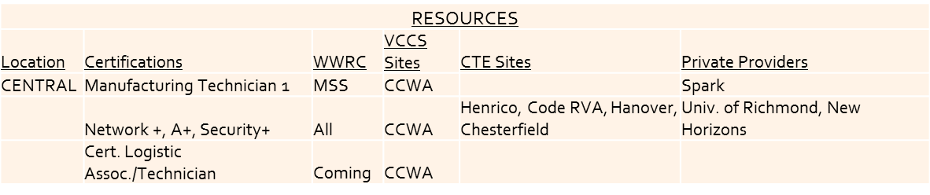
Training Resources
Certification Programs – Details…

Slide 85
Support for Training
Supports for passing certification process: Providing the correct accommodations for the testing process - more time, test read aloud – or reading software, calculator, retakes; Peer group support and study sessions; additional time in class.
Behavioral Supports for ADHD, Autism, Mental Health: Evaluation and treatment / medication to assist with behaviors that interfere with class work / work potential
Sensory processing needs: Sensory processing evaluation, trial of sensory AT, adjust schedules or routines to accommodate needs, incorporating changes from school to work.
Tutoring: provided by Adult Ed or WWRC teachers, and / or classroom instructors

Slide 86
Assistive Technology
Loaner Assistive Technology: CPID has a loaner library for participates in the program and beyond.
CPID has investigated AT specifically for manufacturing.
Previous need for AT is now filled due to lean manufacturing and good ergonomics
Referral to AT Specialist and Rehab Engineer may be needed if there is a specific need.

Slide 87
What Questions Do You All Still Have?
Talk in Small Group Discussions

Slide 88
Activity 3
Looking back at the pre-training assessment, how has your understanding of a career pathways approach changed?
Work in small groups and develop a listing of questions you still have after hearing the info shared all day.
We will process your responses shortly as a group.

Slide 89

Share Your Thoughts/Process

Slide 90
How do I access CPID for my clients?
The short answer is:
If you are interested in learning about Career Pathways or Manufacturing, IT OR Logistics training or academies, please email your single point of contact:
For DBVI: Tish Harris at Tish.Harris@DBVI.virginia.gov
For DARS: Emily West at Emily.West@DARS.virginia.gov
Any staff member can refer an individual to the program. Tish and Emily can provide program information, coordinate with other grant staff, arrange assessments, and offer resources to assist the individuals that we serve in planning and entering a career pathway.
https://www.vadars.org/gsp/cpid/cpid_home.htm

Slide 91
Some Related Topics
Max Initiative
Financial Health Assessment

Slide 92

Follow Up Questions?
Rob Froehlich
(804)794-6667
rfro@gwu.edu
Maureen McGuire-Kuletz
(202)994-9428
mkuletz@gwu.edu

Slide 93

Thanks For Your Participation

